Slide 1
Capstone Project

Slide 2
The Battle of the Neighborhoods Osaka vs Manhattan
Purpose
This document provides the details of my final peer reviewed assignment for the IBM Data Science Professional Certificate program –Coursera Capstone. In this project, it is aimed to compare the neighborhoods of Osaka and Manhattan and determine how similar or dissimilar they are.

Slide 3
Table of contents
Introduction: Business Problem
Data Acquisition
Methodology Analysis
Results and Discussion
Conclusion

Slide 4
Introduction: Business Problem
Osaka is one of the most famous cities in Japan. My friend is moving from Manhattan, NY to Osaka for a career change.
The topic assumed here is to help her to find a place living in Osaka where the environment is similar to her previous home in Manhattan. In this project, I will cluster the venues of all neighborhoods in both cities and make a comparison to understand the similarity and dissimilarity of them. I will also collect and provide a data driven recommendation about where to eat or visit in Osaka.

Slide 5
Data Acquisition
Osaka neighborhoods names
Osaka districts names will be retrieved from Wikipedia: https://en.wikipedia.org/wiki/Osaka
Osaka , Manhattan and their neighborhoods location
Data coordinates of Osaka and Manhattan's neighborhood will be retrieved using google API.
Osaka top Venue recommendations
(Foursquare Category: https://developer.foursquare.com/docs/resources/categories)
Osaka and Mahattan's neighborhoods are explored using Foursquare API . The following information are retrieved.
Venue ID
Venue name
Coordinates: Latitude and Longitude
Category names
Venue ratings (Due to the Foursquare access limitation, only 2 types of ratings were retrieved in this project)

Slide 6
Methodology Analysis
The website information will be retrieved using Beutifulsoup tool.
Using Pandas for proper cleaning to create a dataframe.
The locations are marked upon the map to obtain the co-ordinates of the places via the Geocoding API from Google. Combine with FourSquare API which provides venues in different categories of Osaka and Manhattan. The weighted matrix can be applied on 10 top categories with venues information to generate a ranking result.
K-means clustering algorithm will be use to analyze the similarity or dissimilarity between two cities.
For exploring the Osaka, Foursquare API were queried to get to most highest score food restaurant and so on.

Slide 7
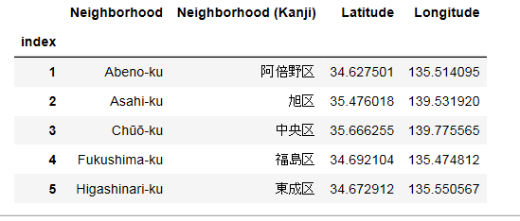
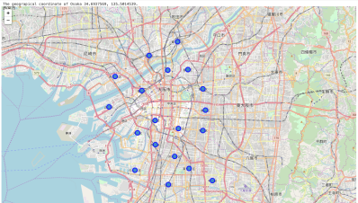
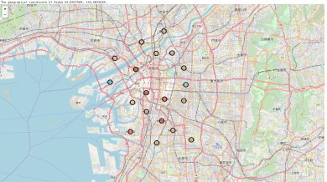
Results and Discussion The diversity of neighborhoods in Osaka
For this analyze, I located 24 neighborhoods in Osaka search in google map. The coordinators are shown in the table. Only top 5 rows are shown here.
Then these neighborhoods are clustered using k-mean methods by analyzing venues counts and categories. The top 5 common venues in Red circles cluster will shown in the next slide.
On the other hand, the similarities (showing the same color) and dissimilarities (showing the different color) are also displayed here.
After clustering

Slide 8

The top 5 common venues of Red circles clustered neighborhoods in Osaka
----Fukushima-ku---- venue freq
0 Convenience Store 0.15
1 Fast Food Restaurant 0.09
2 Donburi Restaurant 0.07
3 Ramen Restaurant 0.07
4 Chinese Restaurant 0.07
----Naniwa-ku---- venue freq
0 Japanese Curry Restaurant 0.13
1 Convenience Store 0.13
2 Ramen Restaurant 0.07
3 Grocery Store 0.07
4 Train Station 0.07
----Tennōji-ku---- venue freq
0 Bus Stop 0.11
1 Wagashi Place 0.11
2 Intersection 0.11
3 Japanese Curry Restaurant 0.05
4 Restaurant 0.05
----Abeno-ku---- venue freq
0 Convenience Store 0.21
1 Shopping Mall 0.14
2 Liquor Store 0.07
3 Supermarket 0.07
4 Fast Food Restaurant 0.07
----Sumiyoshi-ku----venue freq
0 Convenience Store 0.38
1 Japanese Curry Restaurant 0.08
2 Italian Restaurant 0.08
3 Restaurant 0.08
4 Train Station 0.08

Slide 9
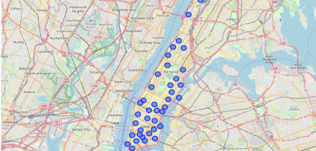
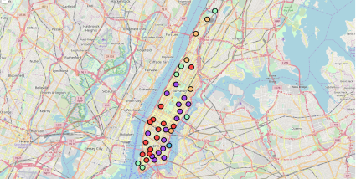
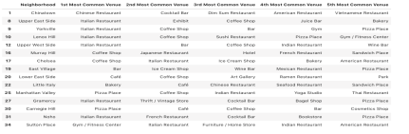
Results and Discussion The diversity of neighborhoods in Manhattan
For this analyze, I located 24 neighborhoods in Manhattan in google map. (fig 1)
By using k-mean method, similar neighborhoods are categorized in the same color. The clusters showed us Manhattan is a very diverse city. (fig2)
The top 5 common venues samples are also displayed here only for our reference. (tab1)
fig.1
fig.2
tab.1

Slide 10
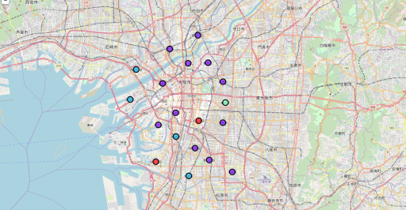
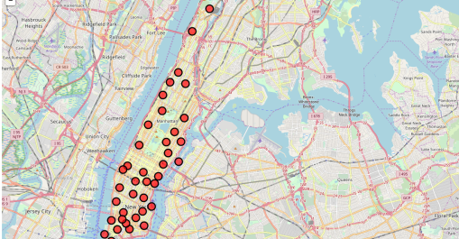
Results and Discussion Osaka vs Manhattan
After both Osaka and Manhattan places information were merged together, the cities were categorized again. I got a very interesting result.
Cluster classification both were changed for each city. Compared to Osaka neighborhoods, Manhattan neighborhoods showed much more similarity (clustered to one category- red circles)
In Osaka neighborhoods, Tennoji-ku and Sumiyoshi-ku showed the most similarity to Manhattan. Other three neighborhoods which were in the same cluster with Tennoji-ku and Sumiyoshi-ku in the previous slide were categorized differently at this time.
Osaka
----Tennōji-ku---- venue freq
0 Bus Stop 0.11
1 Wagashi Place 0.11
2 Intersection 0.11
3 Japanese Curry Restaurant 0.05
4 Restaurant 0.05
----Sumiyoshi-ku----venue freq
0 Convenience Store 0.38
1 Japanese Curry Restaurant 0.08
2 Italian Restaurant 0.08
3 Restaurant 0.08
4 Train Station 0.08
Manhattan

Slide 11
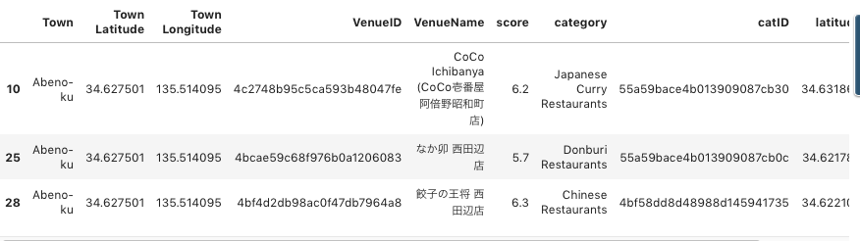
Results and Discussion -Explore Osaka-
Top 3 recommended restaurants in Osaka
The best three restaurants are all located in Abeno-Ku.
(I researches several categories (such as food, ART, museum, cinema et al.) using Foursquare API in order to make a recommendation list. Due to the limitation of accesses to Foursquare API, I only showed the food restaurants results here. )

Slide 12
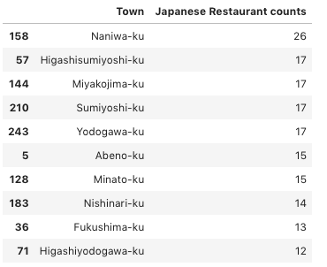
Results and Discussion -Explore Osaka- Top 10 neighborhoods with restaurants numbers
I listed the top 10 neighborhoods in Osaka with Japanese restaurants numbers.
I am very glad to see that one of my recommended city – Sumiyoshi-ku ranked in Number 4!!

Slide 13
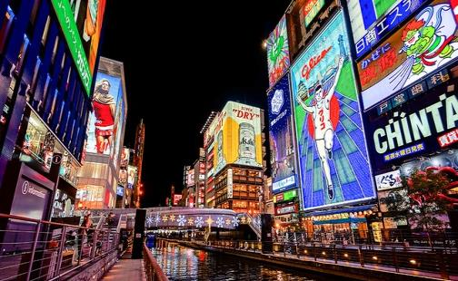
Conclusion
The stakeholder's problem is resolved. This project was aimed to help my friend to find the best place which neighborhood is similar to where she lived before. Compared to Manhattan, Osaka city showed much more diversities of its neighborhoods. Tennōji-ku and Sumiyoshi-ku in Osaka showed the most similarity with Manhattan.
The data showed that Abeno-ku owned the best 3 food restaurants in Osaka. Sumiyoshi-ku ranked in number 4 neighborhoods with Japanese restaurants numbers. As the ranking algorithms was developed, I can quickly ranked every category as I want to recommend to my friend.

Slide 14
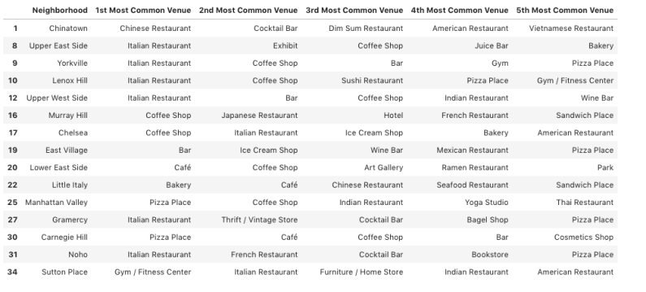
The top 5 in man

Slide 15
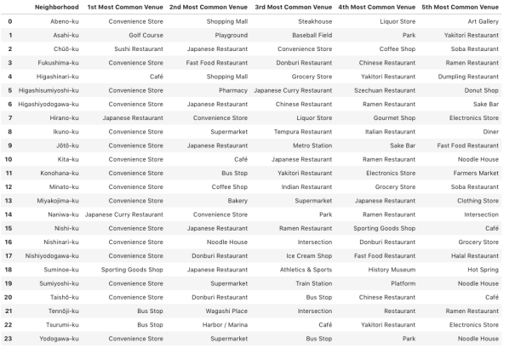

Slide 16
----Abeno-ku----
venue freq
0 Convenience Store 0.21
1 Shopping Mall 0.14
2 Liquor Store 0.07
3 Supermarket 0.07
4 Fast Food Restaurant 0.07
----Asahi-ku----
venue freq
0 Park 0.25
1 Playground 0.25
2 Baseball Field 0.25
3 Golf Course 0.25
4 Arcade 0.00
----Chūō-ku----
venue freq
0 Sushi Restaurant 0.19
1 Japanese Restaurant 0.14
2 Convenience Store 0.09
3 Coffee Shop 0.05
4 Soba Restaurant 0.04
----Fukushima-ku----
venue freq
0 Convenience Store 0.15
1 Fast Food Restaurant 0.09
2 Donburi Restaurant 0.07
3 Ramen Restaurant 0.07
4 Chinese Restaurant 0.07
----Higashinari-ku----
venue freq
0 Grocery Store 0.33
1 Shopping Mall 0.33
2 Café 0.33
3 Sake Bar 0.00
4 Restaurant 0.00
----Higashisumiyoshi-ku----
venue freq
0 Convenience Store 0.25
1 Pharmacy 0.12
2 Japanese Curry Restaurant 0.06
3 Bookstore 0.06
4 Electronics Store 0.06
----Higashiyodogawa-ku----
venue freq
0 Convenience Store 0.28
1 Japanese Restaurant 0.14
2 Chinese Restaurant 0.10
3 Sake Bar 0.07
4 Ramen Restaurant 0.07
----Hirano-ku----
venue freq
0 Japanese Restaurant 0.33
1 Liquor Store 0.33
2 Convenience Store 0.33
3 Pet Store 0.00
4 Sake Bar 0.00
----Ikuno-ku----
venue freq
0 Convenience Store 0.27
1 Drugstore 0.09
2 Tempura Restaurant 0.09
3 Diner 0.09
4 Supermarket 0.09
----Jōtō-ku----
venue freq
0 Convenience Store 0.33
1 Café 0.07
2 Metro Station 0.07
3 Platform 0.07
4 Dessert Shop 0.07
----Kita-ku----
venue freq
0 Convenience Store 0.24
1 Café 0.09
2 Ramen Restaurant 0.06
3 Japanese Restaurant 0.06
4 Noodle House 0.04
----Nishinari-ku----
venue freq
0 Convenience Store 0.55
1 Chinese Restaurant 0.09
2 Donburi Restaurant 0.09
3 Intersection 0.09
4 Noodle House 0.09
----Nishiyodogawa-ku----
venue freq
0 Convenience Store 0.42
1 Supermarket 0.08
2 Fast Food Restaurant 0.08
3 Donburi Restaurant 0.08
4 Ice Cream Shop 0.08
----Suminoe-ku----
venue freq
0 Sporting Goods Shop 0.15
1 Arcade 0.08
2 History Museum 0.08
3 Soccer Field 0.08
4 Restaurant 0.08
----Sumiyoshi-ku----
venue freq
0 Convenience Store 0.38
1 Japanese Curry Restaurant 0.08
2 Italian Restaurant 0.08
3 Restaurant 0.08
4 Train Station 0.08
----Taishō-ku----
venue freq
0 Convenience Store 0.27
1 Donburi Restaurant 0.13
2 Fast Food Restaurant 0.07
3 Athletics & Sports 0.07
4 Donut Shop 0.07
----Konohana-ku----
venue freq
0 Convenience Store 0.67
1 Bus Stop 0.33
2 Sandwich Place 0.00
3 Rock Club 0.00
4 Restaurant 0.00
----Minato-ku----
venue freq
0 Convenience Store 0.18
1 Coffee Shop 0.09
2 Soba Restaurant 0.06
3 Indian Restaurant 0.06
4 Grocery Store 0.06
----Miyakojima-ku----
venue freq
0 Convenience Store 0.28
1 Bakery 0.10
2 Supermarket 0.08
3 Japanese Restaurant 0.05
4 Clothing Store 0.05
----Naniwa-ku----
venue freq
0 Japanese Curry Restaurant 0.13
1 Convenience Store 0.13
2 Ramen Restaurant 0.07
3 Grocery Store 0.07
4 Train Station 0.07

Slide 17
----Tennōji-ku----
venue freq
0 Bus Stop 0.11
1 Wagashi Place 0.11
2 Intersection 0.11
3 Japanese Curry Restaurant 0.05
4 Restaurant 0.05
----Tsurumi-ku----
venue freq
0 Bus Stop 0.33
1 Café 0.33
2 Harbor / Marina 0.33
3 Rock Club 0.00
4 Restaurant 0.00
----Yodogawa-ku----
venue freq
0 Convenience Store 0.31
1 Supermarket 0.15
2 Park 0.08
3 Intersection 0.08
4 Ramen Restaurant 0.08

Slide 18
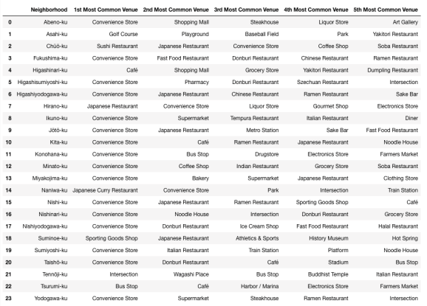
The top5 common venues of each wards in Osaka

